Slide 1

Problem Statement and Team Details
Problem Statement: Current research tools are fragmented and inefficient, wasting time and providing unreliable, outdated information.
Team Name: CodeGoblins
Team Leader Name: Niteesh Suryadevara
Institute Name: KLH bachupally
Team Leader Email ID: 2420030178@klh.edu.in

Slide 2
Problem and Solution
Problem:
Current research tools are fragmented across multiple platforms and lack integration, causing inefficiencies and wasted time for users. Researchers, students, and professionals struggle with piecing together information from different sources, often receiving shallow or outdated insights without clear citations. This fragmentation limits the depth and reliability of research, making the process tedious and error-prone.
Solution:
Our solution addresses this by creating a Smart Research Assistant that unifies search from uploaded files and live online data, automatically extracting, summarizing, and citing key insights. It offers a user-friendly app for asking questions and generating structured, reliable reports, with integrated billing and usage tracking. Live data updates ensure that answers remain fresh, enabling faster and more trustworthy research for all users.
.

Slide 3
Methodology & Implementation
The implementation approach for the Smart Research Assistant includes these key steps:
User Input Interface: Develop a simple frontend app where users can type their research questions.
Backend Pipeline:
Upload and index multiple files for semantic search.
Integrate a live data source (e.g., news/blogs) via Pathway for continual ingestion and updates.
Use AI models to search across these sources, extract relevant information, and summarize into structured reports with citations.
Live Update Mechanism: Leverage Pathway to keep data fresh by incrementally ingesting new information so answers evolve with the latest content.
Usage Tracking and Billing: Integrate Flexprice to meter questions and reports, enforce credit limits, and display usage counters in the app dashboard.
Dashboard & Reporting UX: Build a dashboard that shows clear key takeaways, source links, report counts, and credit consumption to ensure transparency and ease for non-technical users.
Evaluation and Iteration: Continuously refine the prompts, models, and UI based on user feedback for depth, clarity, and seamless experience.

Slide 4
Technology Used
Frontend: Use React.js or simple HTML/CSS/JavaScript for building the user interface where users can input questions and see answers.
Backend: Use Python with Flask or FastAPI (easy to learn and quick to build APIs).
File Processing: Use existing Python libraries like PyPDF2 or python-docx to read uploaded files.
AI Model: Use OpenAI’s GPT API or similar pre-trained language models through simple API calls for summarizing and answering questions.
Search: Implement basic keyword search using Python (like using Whoosh or simple text matching) to avoid complex vector stores.
Live Data: Simulate live updates by periodically fetching news/blog RSS feeds and storing them in your backend (no need for complex streaming frameworks).
Usage Tracking: Use simple counters in your backend and frontend to show how many questions or reports were generated.
Billing Concept: Just simulate billing by decrementing credits stored in a database or file; real payment integration can be skipped for the hackathon.
Hosting: Use free platforms like Heroku, Vercel, or GitHub Pages for deployment.

Slide 5
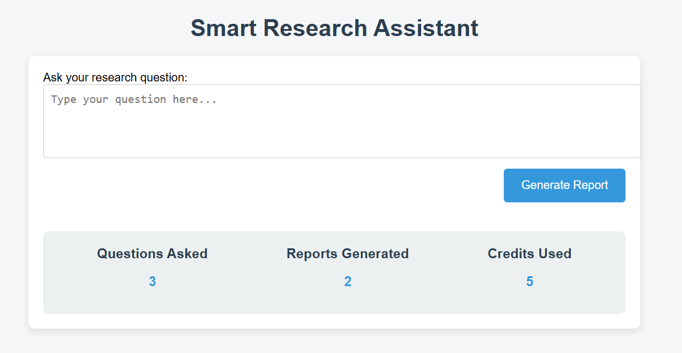
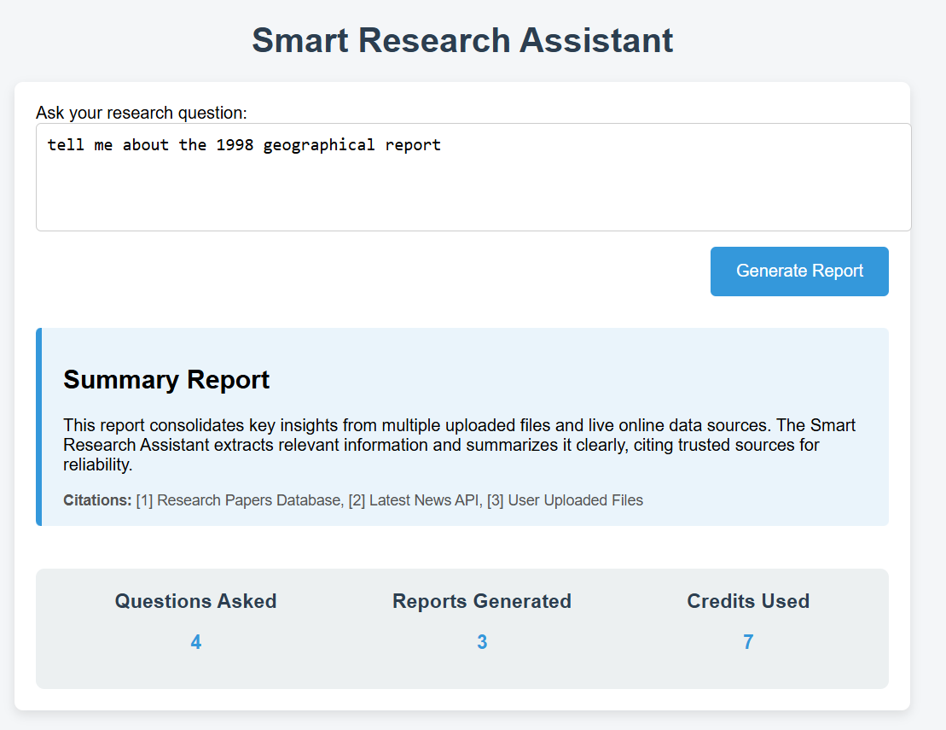
Flowchart & Supporting Images
User inputs research question ↓
System searches uploaded files and live data sources ↓
AI extracts key points and summarizes with citations ↓
Structured report is generated and displayed to user ↓
Usage counters (questions, reports, credits) are updated in the dashboard
Supporting Images

Slide 6
Feasibility and Market Use
The Smart Research Assistant is feasible for a hackathon or early-stage project because it leverages existing AI models (like OpenAI’s GPT) and commonly available tools for file processing and data ingestion. The core components—semantic search, summarization, and citation—can be implemented using APIs and simple backend logic without building complex systems from scratch. Usage tracking and billing simulation can be done with basic database counters, making the MVP achievable within a short timeframe and manageable skill level.
This tool can appeal broadly to:
Students and Academics: Simplifies assignment and thesis research by providing quick, reliable summaries with sources.
Startup and Business Teams: Streamlines market research, competitor analysis, and report writing through consolidated insights.
Educators: Helps prepare materials and verify facts efficiently.
Content Creators and Analysts: Supports content curation by aggregating and summarizing fresh data from multiple sources.

Slide 7
Conclusion
In conclusion, the Smart Research Assistant addresses the critical challenge of fragmented and inefficient research tools by integrating multiple data sources and AI-powered summarization with citation. This results in concise, trustworthy reports that save time and improve knowledge depth for students, educators, and professionals. Its feasible implementation using existing AI and web technologies, combined with live data updates and usage-based billing, positions it well for the growing market demand in educational and business research spaces. This solution offers both practicality and innovation, making research easier, faster, and more reliable.

